Slide 1
Global life expectancies

Slide 2
The dataset
Life Expectancy: Statistical estimate of average remaining years of life at a given age. It reflects the quality of living conditions and healthcare of a country or region.
3 Datasets :
Life expectancy (4 Columns, 20755 rows)
Life expectancy by age group (9 Columns, 20755 rows)
Life expectancy gap between males and females (4 Columns, 19922)
Originally released by “Our World in Data” and then shared in “TidyTuesday”.

Slide 3
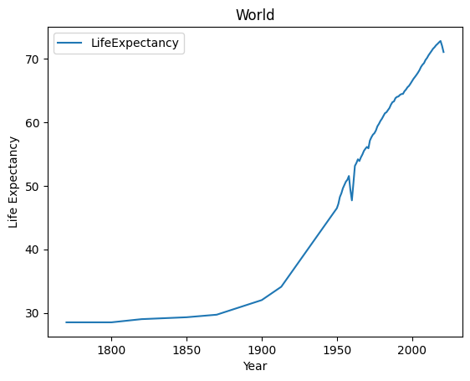
World average life expectancy from 1770 to 2021
Average life expectancy rate from 1770 to 2021
Significant rise from 1950
Brief sharp decline in 1959-1961
Line continues to climb until 2021
Probable Cause:
Famine in China between 1959 and 1961
Notes:
This simple line graph shows the trend of life expectancy from the year 1770 until 2021.
The line slowly rises throughout the years, and somewhere between 1900 to 1950 there is a significant increase. The line has a sharp but brief decline between 1959 to 1961 and goes up again with peak life expectancy is 2019.
The probable cause of the brief decline was because of the famine in China in that period. Since China is the biggest contributor because of their population, famine might have a significant impact on the average world life expectancy.

Slide 4
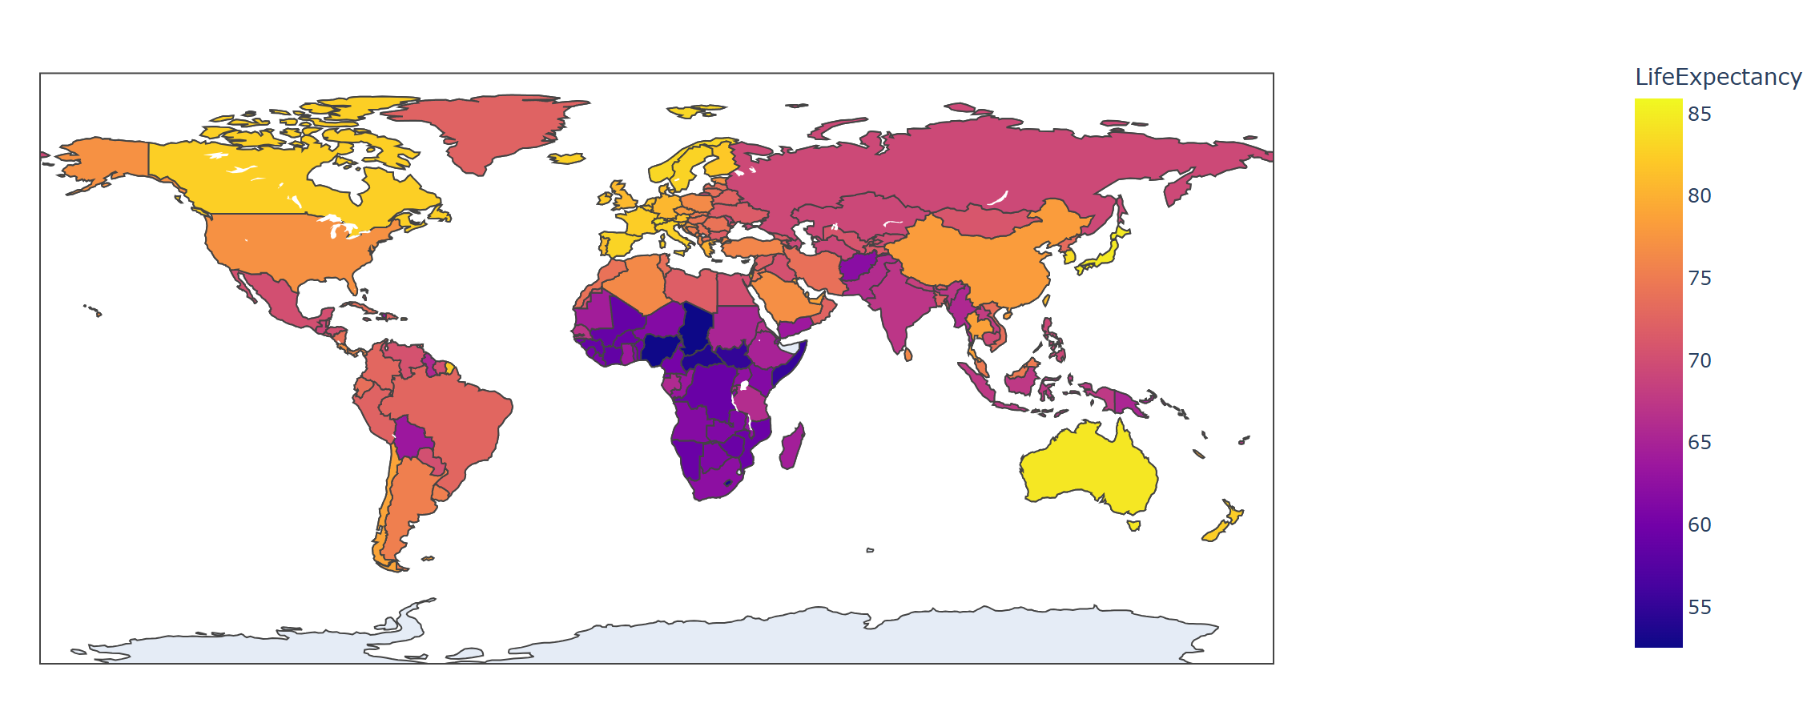
Global life expectancies in 2021
In 2021, the Country with the highest life expectancy is Monaco (85.95) and the lowest is Chad (52.53)
African countries generally have lower life expectancy
Notes:
The choropleth map can show life expectancies of different countries neatly
The map shows the global average life expectancy in 2021. Europe generally has a higher life expectancy, as shown by the yellow colours in most of its countries. while Africa has typically lower life expectancy shown by the dark purple colors of most of its countries.

Slide 5
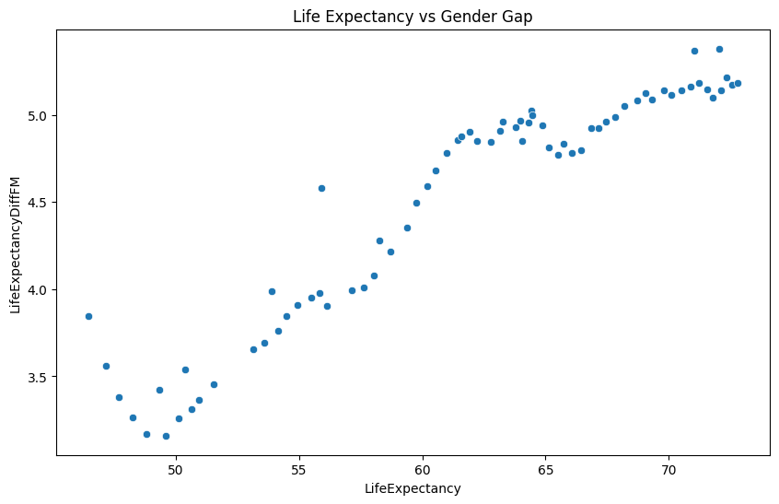
World average life expectancy vs life expectancy gap between male-female
There is a trend that the Higher the life expectancy, the bigger the gap in life expectancy between males and females.
This is probably caused by behavior.
Notes:
This scatter plot shows the relationship between world average life expectancy and the gender gap in life expectancy. It shows that there is a trend that the gap in life expectancy grows bigger as the average life expectancy improves. This might be because men tend to have a behavior that would shorten their lifespan, such as consuming tobacco, which could lead to heart attacks or cancer.

Slide 6
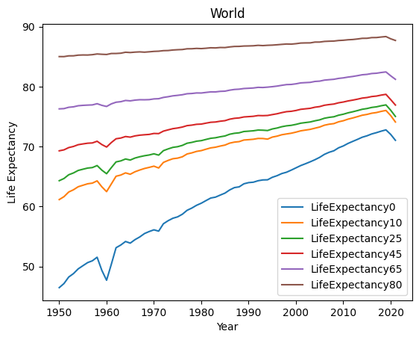
World average life expectancy by age group
The graph shows that the higher/older the age group the flatter the trendline becomes.
This is because as people grows older, their life expectancy diminishes.
Notes:
What does life expectancy by age group mean? :
LifeExpectancy0 started calculating from birth (0 y.o), so LifeExpectancy10 means the life expectancy when they are 10 years old and so on.
In the graph it shows that the higher the age group, the flatter the line becomes, this is because as people grows older, their life expectancy diminishes. Say, not many people can live until 100 years old. Which is why the difference between starting age to life expectancy gets more narrow.

Slide 7
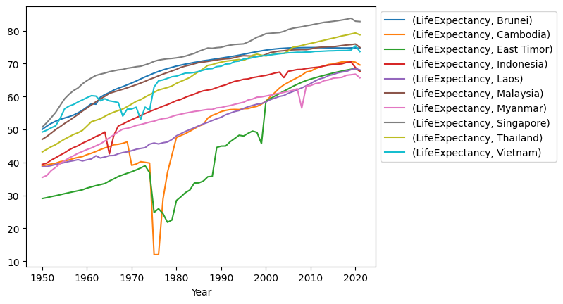
Life expectancy of Southeast Asia from 1950 to 2021
Singapore has the highest life expectancy from 1950-2021
Cambodia, East Timor and Vietnam had a sharp decline. With Cambodia being the sharpest.
This was probably caused by wars, famine, and genocide in the 1970s
Notes:
I took a sample of one of the regions of the world to be made into a multi-line graph.
I chose Southeast Asia because I’m more familiar. In 1950, Singapore had the highest life expectancy and East Timor had the lowest. In 2021, Singapore had the highest life expectancy again, however, this time the lowest was Myanmar. If we look at the lines, there are a few countries that had a quite big decline in life expectancy in the 1970s. These countries are Cambodia, East Timor, and Vietnam. The causes of this are wars, famine and genocide. For Cambodia, the very sharp decline was caused by the violence perpetrated by the Khmer Rouge. For East Timor, it might be caused by the invasion and occupation/annexation of the country by Indonesia. The life expectancy of East Timor only managed to bounce back after its independence from Indonesia in 2002. For Vietnam, it was war.

Slide 8
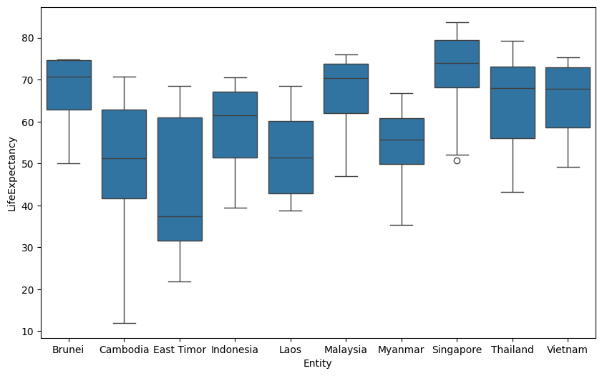
Box plots of average life expectancy in southeast asia from 1950 to 2021
Cambodia has the widest whisker
East Timor has the largest interquartile range
The smaller the range, the stabler the life expectancy
Notes:
This boxplot shows the spread of life expectancy of different countries in Southeast Asia. As expected, Cambodia and East Timor has two of the largest spread and outliers due to fluctuations during the 1970s.

Slide 9
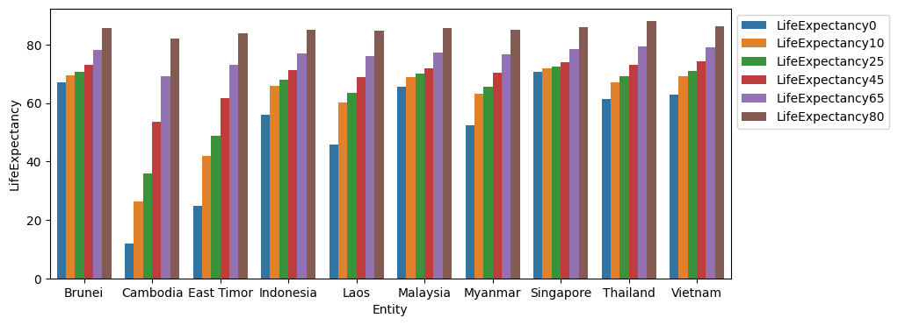
Bar chart of average life expectancy by age group in southeast asia in 1975.
Cambodia and East Timor had the biggest difference of life expectancy between age groups.
Life expectancy at the age 80 years old are similar across countries.
Notes:
This grouped bar chart shows the comparison of life expectancy between Southeast Asian countries. Cambodia and East Timor has large differences of life expectancy between age group.

Slide 10
Evaluation
Challenges:
Figuring out how to present a large dataset so it can be representative
Deciding which graph should be used and presented
Tidying up the codes written
Using Git effectively

Slide 11
References
Link to datasheet from TidyTuesday:
https://github.com/rfordatascience/tidytuesday/blob/main/data/2023/2023-12-05/readme.md

Slide 12
THANK YOU

